Slide 1
Self-Attention
Idea and Principle

Slide 2
Sophisticated Input
Input is a vector
Input is a set of vectors
Model
Scalar or Class
Model
Scalars or Classes
may change length

Slide 3
What is the output?
Each vector has a label.
The whole sequence has a label
Model
N
N
Model
Model decides the number of labels itself.
seq2seq
Model
N
Translation
N’

Slide 4
Sequence Learning
Is it possible to consider the context?
FC can consider the neighbor, but how to consider the whole inputs?
a window cover the whole sequence?
FC
Fully-connected
FC
FC
FC
FC
window
I
saw
a
saw

Slide 5
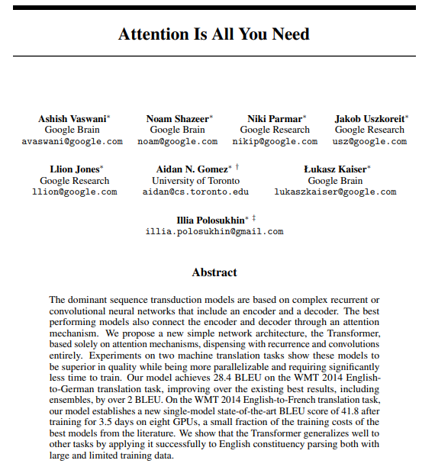
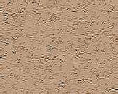
Self-attention
Attention is All You Need
FC
FC
FC
FC
with context
Self-attention
https://arxiv.org/abs/1706.03762

Slide 6


FC
FC
FC
FC
Self-attention
FC
FC
FC
FC
Self-attention
https://arxiv.org/abs/1706.03762

Slide 7








Self-attention
$$b^{1}$$
$$b^{2}$$
$$b^{3}$$
$$b^{4}$$
$$a^{1}$$
$$a^{2}$$
$$a^{3}$$
$$a^{4}$$
Can be either input or a hidden layer

Slide 8






How to get the relavance?
$$b^{1}$$
$$α$$
relevant?
$$a^{1}$$
$$a^{2}$$
$$a^{3}$$
$$a^{4}$$
Find the relevant vectors in a sequence

Slide 9
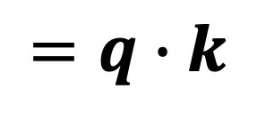



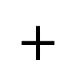
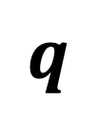






Self-attention
$$α$$
Additive
$$W$$
Dot-product
$$α$$
$$=q∙k$$
$$tanh$$
$$q$$
$$k$$
$$+$$
$$W^{q}$$
$$W^{k}$$
$$W^{q}$$
$$W^{k}$$
Notes:
Does normalization important???

Slide 10













Self-attention
$$α_{1,2}=q^{1}∙k^{2}$$
$$α_{1,3}=q^{1}∙k^{3}$$
$$α_{1,4}=q^{1}∙k^{4}$$
attention score
$$α_{1,2}$$
$$α_{1,3}$$
$$α_{1,4}$$
q¹
query
$$k^{2}$$
key
$$k^{3}$$
$$k^{4}$$
$$a^{1}$$
$$a^{2}$$
$$a^{3}$$
$$a^{4}$$
$$q^{1}=W^{q}a^{1}$$
$$k^{2}=W^{k}a^{2}$$
$$k^{3}=W^{k}a^{3}$$
$$k^{4}=W^{k}a^{4}$$

Slide 11



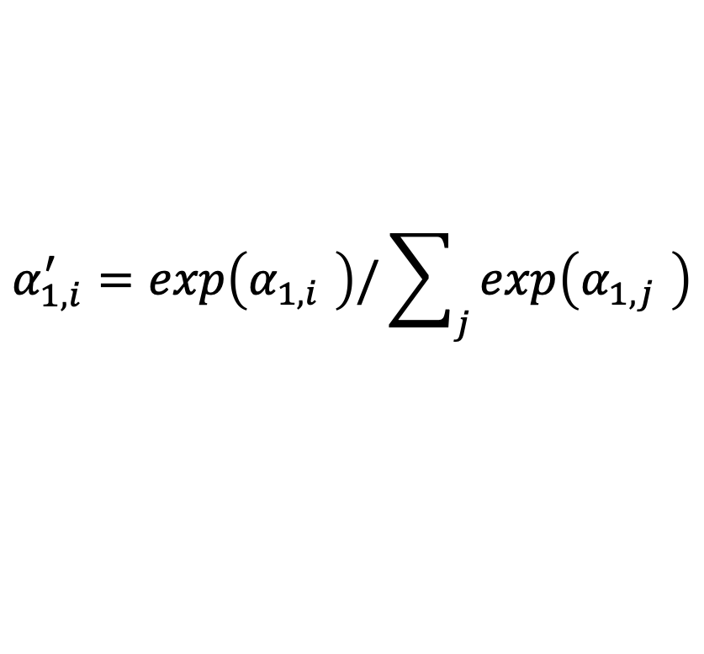





Self-attention
$$α_{1,i}^{′}=exp\left(α_{1,i} \right)/\sum_{j}{exp\left(α_{1,j} \right)}$$
$$α_{1,1}^{′}$$
$$α_{1,2}^{′}$$
$$α_{1,3}^{′}$$
$$α_{1,4}^{′}$$
Soft-max
$$α_{1,1}$$
$$α_{1,2}$$
$$α_{1,3}$$
$$α_{1,4}$$
$$q^{1}$$
$$k^{1}$$
$$k^{2}$$
$$k^{3}$$
$$k^{4}$$
$$a^{1}$$
$$a^{2}$$
$$a^{3}$$
$$a^{4}$$
$$q^{1}=W^{q}a^{1}$$
$$k^{2}=W^{k}a^{2}$$
$$k^{3}=W^{k}a^{3}$$
$$k^{4}=W^{k}a^{4}$$
$$k^{1}=W^{k}a^{1}$$

Slide 12


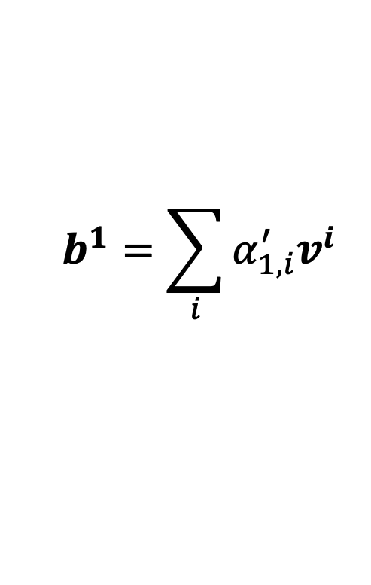






Self-attention
Extract information based on attention scores
$$b^{1}=\sum_{i}{α_{1,i}^{′}v^{i} }$$
$$b^{1}$$
$$α_{1,1}^{′}$$
$$α_{1,2}^{′}$$
$$α_{1,3}^{′}$$
$$α_{1,4}^{′}$$
$$q^{1}$$
$$k^{1}$$
$$v^{1}$$
$$k^{2}$$
$$v^{2}$$
$$k^{3}$$
$$v^{3}$$
$$k^{4}$$
$$v^{4}$$
$$a^{1}$$
$$a^{2}$$
$$a^{3}$$
$$a^{4}$$
$$v^{1}=W^{v}a^{1}$$
$$v^{2}=W^{v}a^{2}$$
$$v^{3}=W^{v}a^{3}$$
$$v^{4}=W^{v}a^{4}$$

